Slide 1
Cycle 3 Group 3
SKY RACERS
Thomas Gadek, Nicholas Knowles, Emmanuel Owusu, Jeffrey Perreault, Timothy Scott

Slide 2

Agenda
Manny
Added Features
Install/Uninstall
Demos
Process/Tools/Standards
Lessons Learned

Slide 3
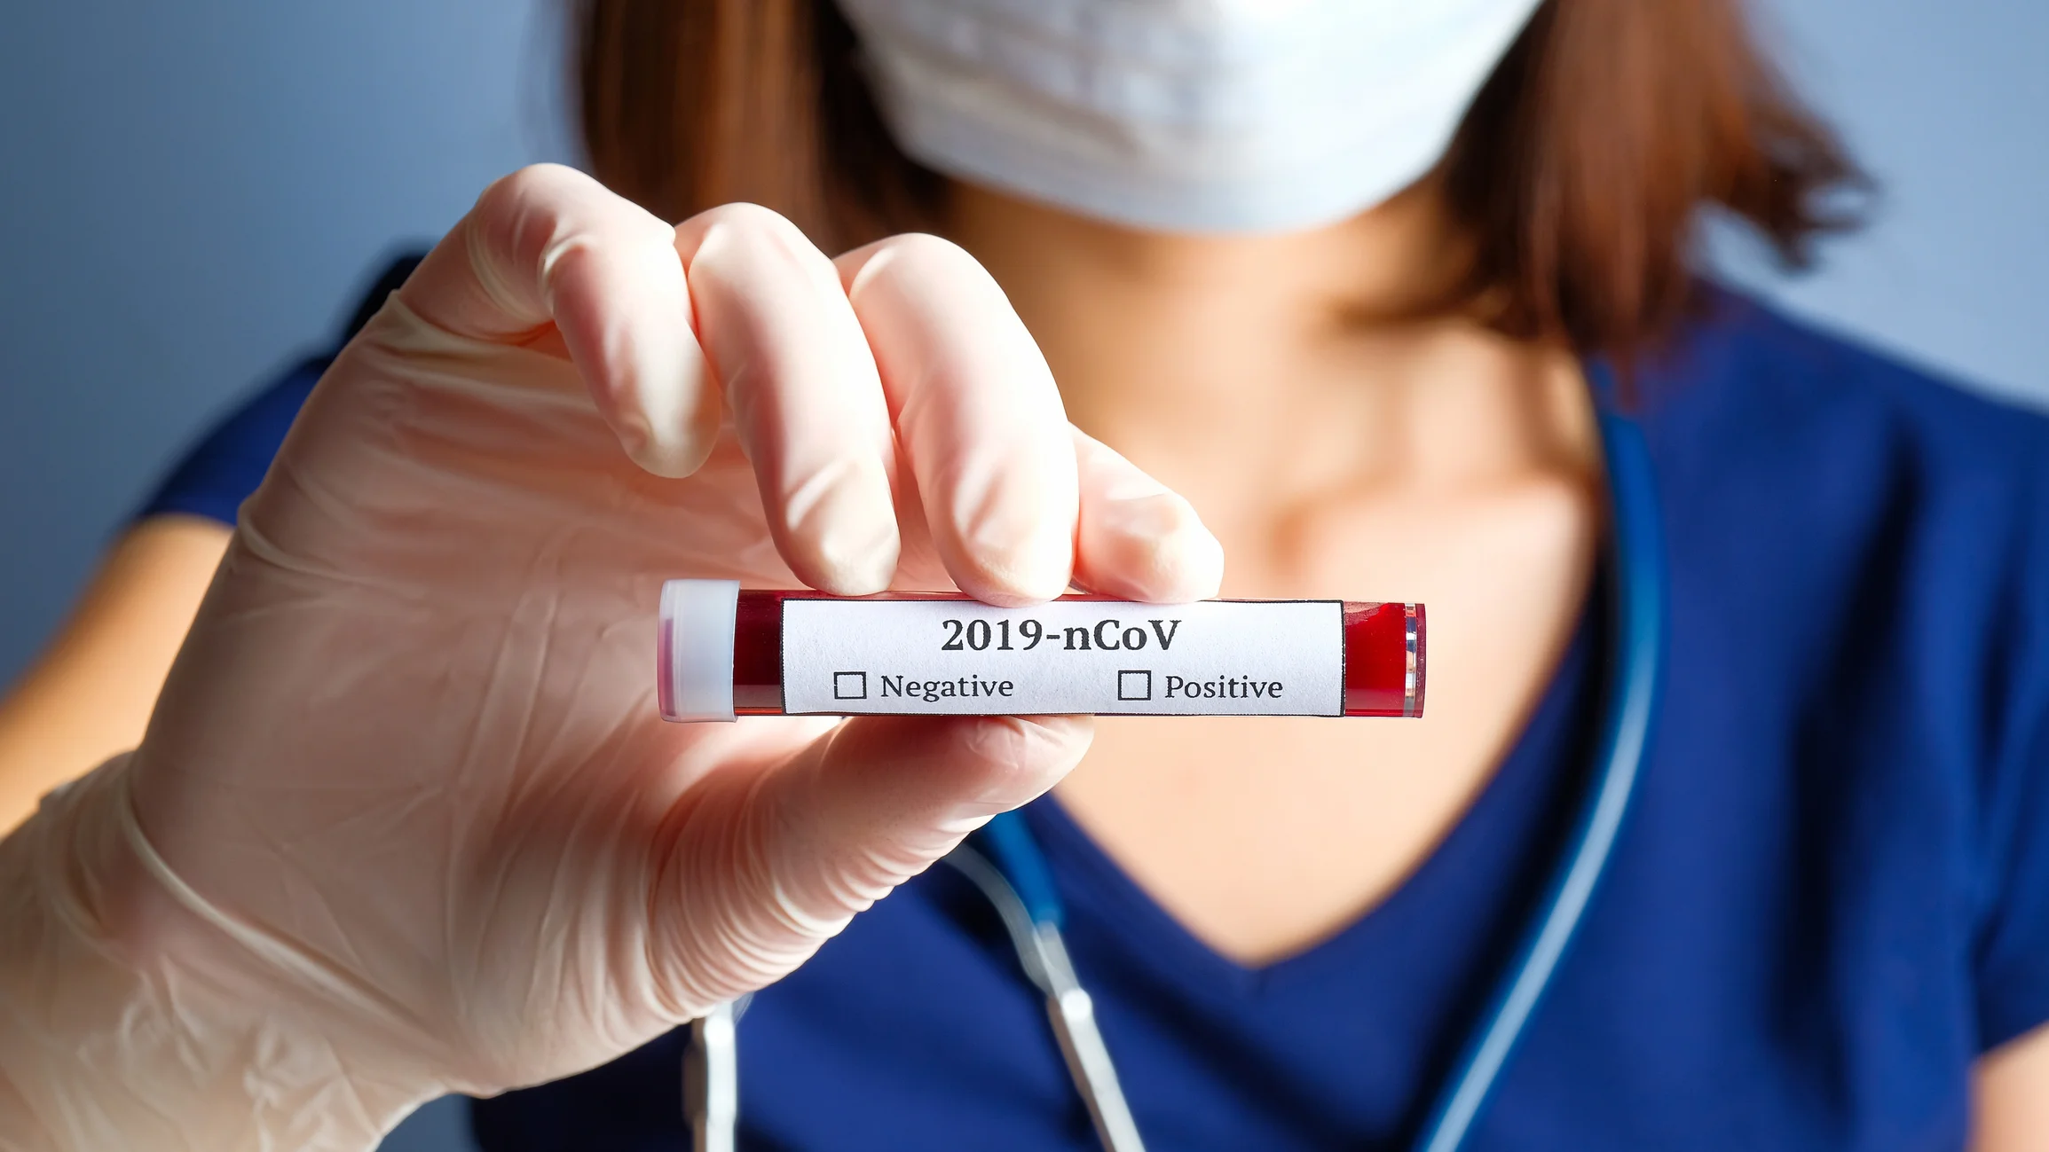
Tests and Added Features
Nick
User Interface
High Scores
AI improvements
Physics Test Finished

Slide 4
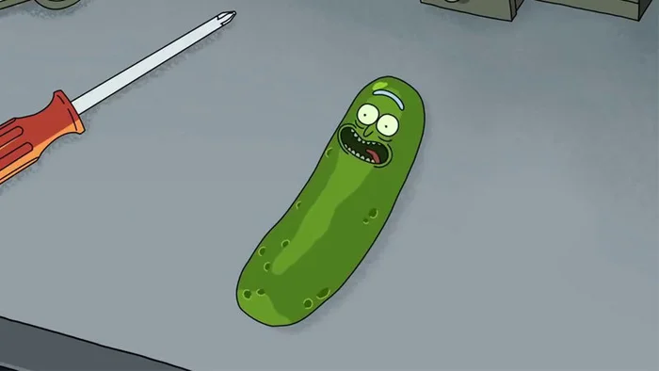
Dependencies Needed for Install
Jeff
Python 3
pip3
PyGame
pybox2d
pickle-mixin

Slide 5
Install and Demo

Slide 6

Process/Tools/Standards
Tim
BitBucket was used for code organization and management
Weekly Status Reports, hours and feature progress
Testing and code review of every completed feature

Slide 7
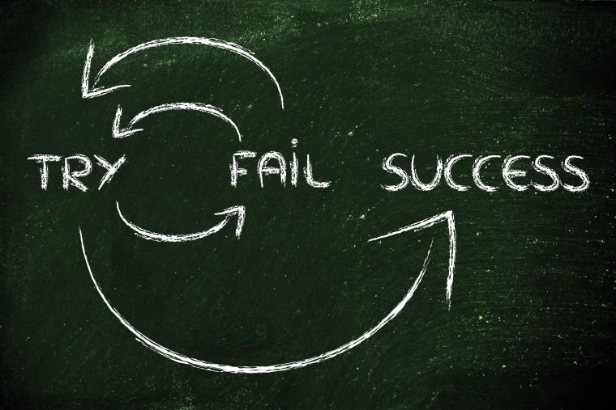
Lessons Learned
Tom
Using Bash commands to Install python projects in Linux and Windows
We learned there was a Sounds object bug that had to be avoided with Mixers.

Slide 8
THANK YOU

